Slide 1
Lightning Talk: Project Planning
Hybrid Relightable 3D Gaussian Rendering: A Real-Time Novel View Synthesis System with Triangle Mesh Integration (sdmay25-40)

Slide 2
Project Overview
Our project is a novel view synthesis system that uses 3D Gaussian splats with a raytracer that allows for real time dynamic lighting and the incorporation of traditional polygon meshes.
Use a Machine Learning model to extract material properties from videos to allow for dynamic lighting.
Create a Unity package consisting of our renderer

Slide 3
Problem Statement
Generate new images of a scene under different lighting conditions with new additional objects from a specific point of view using pictures of the scene from different points of view.

Slide 4
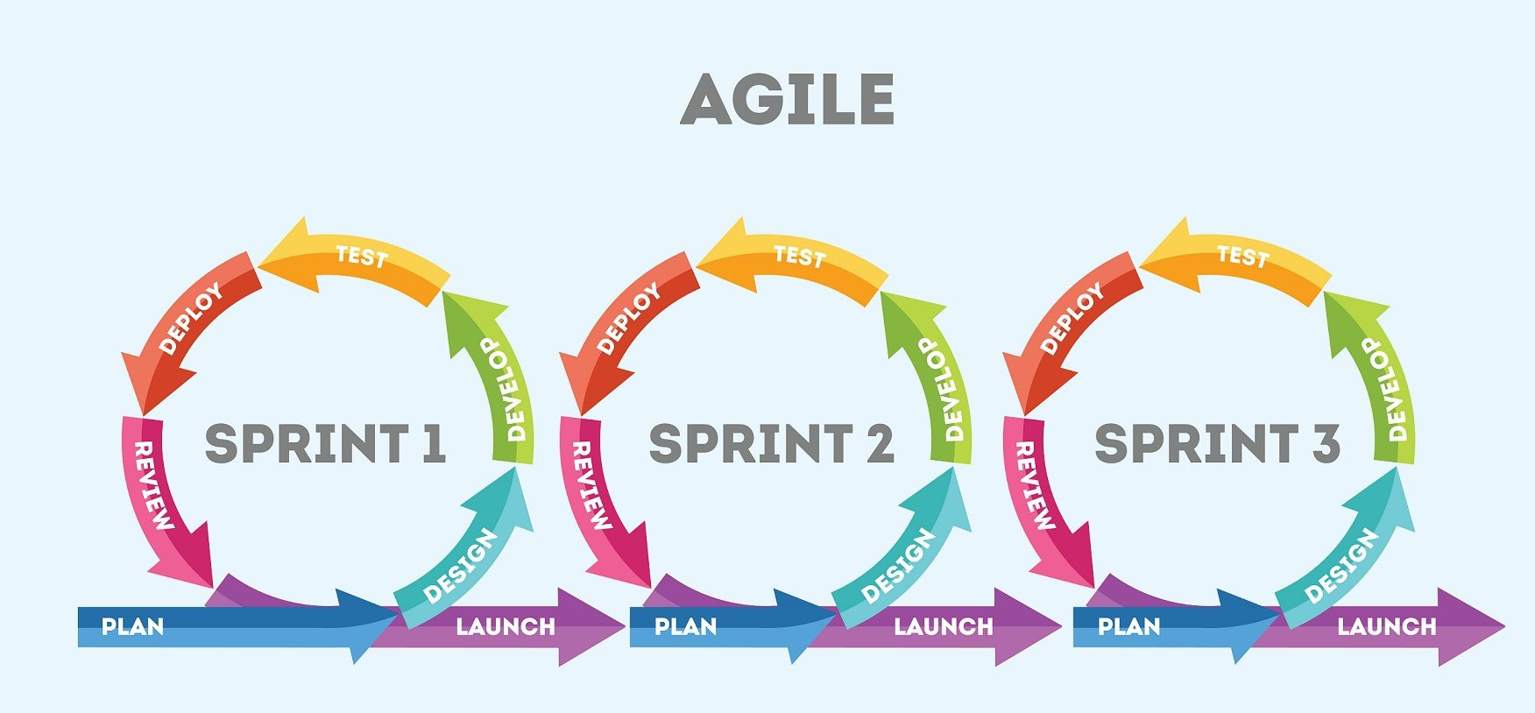
Project Management Style
We will be managing our project using the Agile methodology as we are all familiar and have used it in the past.
Sprint Length: 2 weeks to be consistent with advisor meeting times

Slide 5
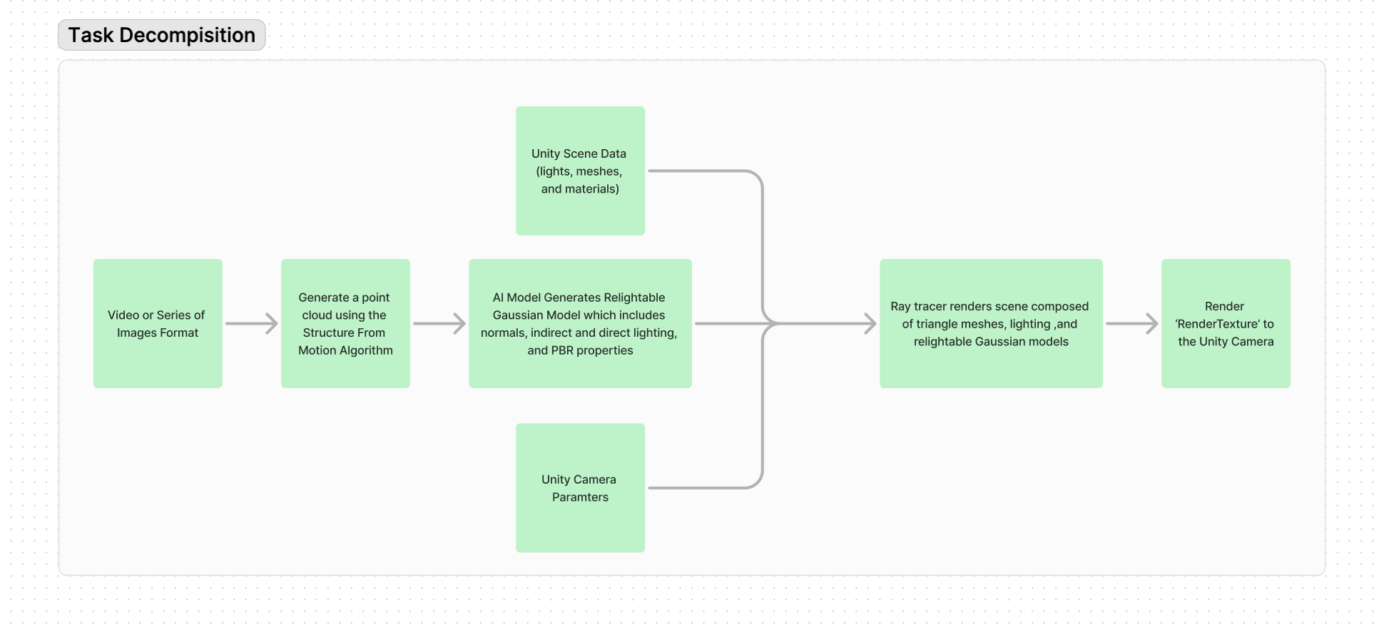
Task Decomposition

Slide 6
Key Milestones
Ray-Gaussian Intersection
The raytracer is successfully calculating if a ray it casts intersects with a 3D Gaussian
Ray-Polygon Intersection
The raytracer is successfully calculating if a ray it casts intersects with a polygon face.
ML Model extracting Surface Normals
The ML Model is successfully analyzing a given point set and extracting Normals from surfaces
ML Model extracting PBR Properties
The ML Model is successfully analyzing a given point set and extracting material property values used in Physics Based Rendering
Unity Package
A Unity package containing our renderer correctly renders 3D
Gaussians with triangle meshes

Slide 7
Key Risks
Gaussian surface normals ML prediction
Poor quality datasets for ML models
Raytracer performance sustaining 30 frames per second

Slide 8
Conclusion
We are trying to accomplish creating a program that has enhanced performance compared to other novel view synthesis systems, while avoiding the pitfalls of Machine Learning and the real time performance demands.

